Slide 1


SRI RANGAPOOPATHI COLLEGE OF ENGINEERING
(An Autonomous Institution)
(Approved by AICTE, New Delhi & Affiliated to Anna University, Chennai)
Alampoondi, Gingee (T.K), -604151. VillupuramDt, Tamilnadu, India
Website: www.srpce.in Phone.No:04145 231657. Email:srceprince2009@gmail.com.
TEAM MEMBER’S
S.NO | NAME | REGISTER NUMBER | DEPARTMENT
1 | SERAN.M | 422022104039 | CSE
2 | KAVIYA.V | 422022104017 | CSE
3 | PRAVINA.S | 422022104304 | CSE
4 | MOHAN BABU.A | 422022104024 | CSE
Guide
Signature:
HOD
Signature:
Principale
Signature:

Slide 2
Organ Donation & Hospital Coordination Web Platform
Life Share
Notes:
This template is provided by http://www.free-power-point-templates.com/

Slide 3
Project Title:
Organ Donation & Hospital Coordination Web Platform
A Secure Full Stack-Based Web Application for Organ Request and Hospital Coordination.
Domain: Full Stack Web Development
Technology Stack: HTML, CSS, Java Script, Python, React JS, MySQL.

Slide 4
Abstract:
The Organ Donation & Hospital Coordination Web Platform is a secure, web-based healthcare management system developed using the Full stack (Python, React JS, MySQL, Java Script). The system aims to create a centralized platform that connects patients, organ donors, and hospitals for efficient coordination and real-time communication.
Patients can register and submit organ requests. Registered donors can view and respond to requests. Hospitals can manage organ availability, update emergency alerts, and track organ transfer status. The system ensures transparency, faster communication, and reduced organ wastage.
The platform includes secure authentication, real-time organ tracking, emergency notification broadcasting, hospital directory access across India, and an integrated chat system for clarifications regarding organ donation procedures.
This digital solution enhances coordination efficiency and contributes to saving lives through modern web technologies.

Slide 5
Existing System:
The current organ donation coordination system is mostly manual or semi-digital and involves:
Organ donor information is often maintained manually or in separate hospital databases.
Lack of a centralized platform to connect donors and recipients.
Communication between hospitals, donors, and patients is inefficient.
Data management may lead to errors, delays, and lack of transparency.
Phone-based communication between hospitals.
Paper-based documentation.
Separate hospital databases.

Slide 6
Limitations of Existing System:
Time-consuming coordination
High risk of organ wastage
Lack of transparency
No centralized national database
Inefficient emergency response
Limited accessibility for donors and patients
No centralized real-time tracking system
Delayed donor-patient matching
Limited emergency notification system

Slide 7
Proposed System:
The proposed system is a Full-stack-based web application designed to digitally connect:
Patients – Submit organ requests
Donors – View requests and respond
Hospitals – Manage organ availability, emergencies and track status
Allow hospitals or patients to search for suitable donors quickly

Slide 8
Literature Surveys:
SL. NO | TITLE AND AUTHOR | METHODOLOGY USED | ADVANTAGES | DRAWBACKS
1 | "Web-Based Organ Donation Management System" – R. Kumar et al. (2021) | Developed a centralized web platform for donor registration, patient requests, and hospital coordination using a relational database system. | Improves communication between stakeholders and reduces processing delays. | Limited real-time tracking and depends on continuous internet connectivity.
2 | "Hospital Information Management System" – S. Sharma et al. (2022) | Implemented a digital healthcare management system for maintaining patient records and hospital operations. | Enhances data management, accuracy, and operational efficiency. | Requires regular maintenance and staff training.
3 | "Organ Allocation and Tracking System" – M. Patel et al. (2023) | Designed an organ allocation framework with tracking mechanisms to improve organ distribution transparency. | Reduces organ wastage and improves allocation efficiency. | Integration with multiple hospitals can be complex.
4 | "Cloud-Based Healthcare Management System" – A. Verma et al. (2022) | Utilized cloud computing for secure storage, accessibility, and management of healthcare data. | Scalable, accessible, and supports large volumes of data. | Data privacy and cybersecurity concerns may arise.
5 | "Secure Authentication for Healthcare Applications" – P. Singh et al. (2023) | Applied role-based authentication and encrypted access control for healthcare systems. | Protects sensitive medical information and improves system security. | Increased implementation complexity and operational cost.

Slide 9
Key Features:
Secure Role-Based Authentication (JWT-based login system)
Organ Request Management Module
Real-Time Organ Tracking System
Emergency Alert Broadcasting
Hospital Directory (India-wide)
Integrated Chat System
Organ Transfer Status Monitoring
Admin Dashboard for Monitoring and Control

Slide 10
Advantages:
Faster communication between stakeholders
Reduced organ wastage
Transparent organ tracking
Centralized cloud-based database (MySQL)
Scalable and secure architecture
Improved emergency response efficiency

Slide 11
Disadvantages:
Dependence on internet Connectivity
High Maintenance and Operational Costs
Challenges in Verification and Authentication
Data Privacy and Security Risks
Potential Server Downtime

Slide 12
System Requirements:
1)Hardware Requirements:
Processor: Intel i3 or above
RAM: Minimum 4GB (8GB Recommended)
Hard Disk: 250GB or above
Internet Connection

Slide 13
Software Requirements:
Operating System: Windows / Linux / macOS
Frontend: HTML, CSS, Java Script
Backend: Python
Framework: React JS, Flask
Database: MySQL
API Testing Tool: Postman
IDE: VS Code
Web Browser: Chrome / Edge / Firefox
Node Package Manager (NPM)

Slide 14
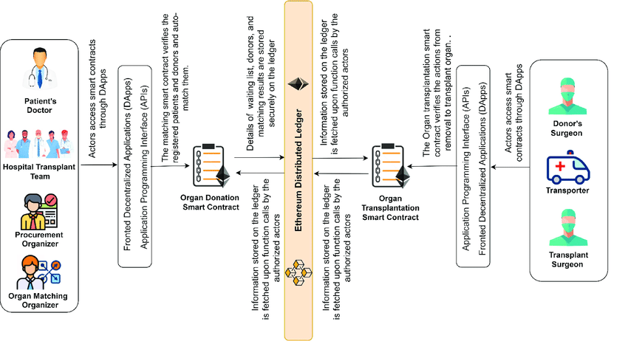
Architecture of Project:

Slide 15
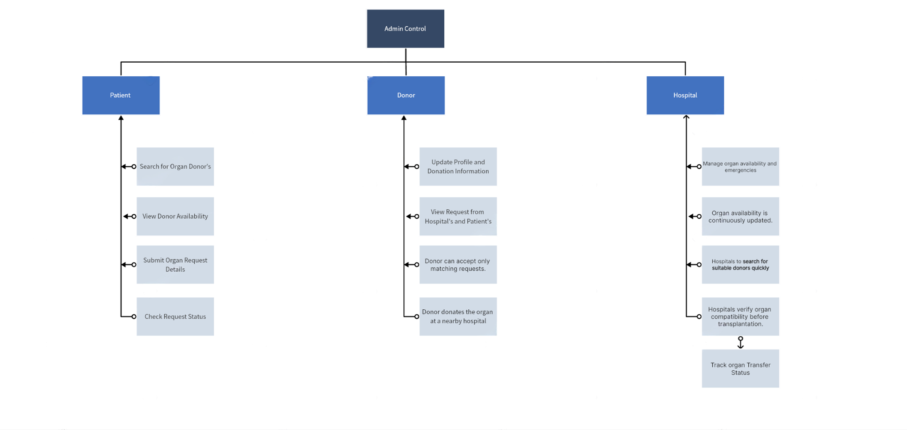
Block of Project:

Slide 16
List Out The Modules Used:
Admin Module:
Manage donor and hospital registrations
View and update donor details
Approve or remove registered users
Monitor organ donation requests and system activities.

Slide 17
2) Donor Module:
Donors can register and create an account
Update profile and donation information
View requests from hospitals or patients
3) Hospital Module:
Hospitals can register and login to the system
Search for available organ donors based on requirements
Track Organ Transfer status.

Slide 18
4) Patient Module:
Patients can search for organ donors
View donor availability
Submit organ request details
Check request status
Advantages Of The System:
Centralized Database
Easy Registration
Quick Donor Search
Data Security

Slide 19
Future Enhancements:
Develop a mobile application for easier access on smartphones
Improve security features to protect sensitive medical data
Add location-based search to find nearby donors and hospitals
Definition of Modules:
In this system, a module refers to a specific functional component that performs a particular task in the organ donation platform. The project is divided into multiple modules such as Admin, Donor, Hospital, and Patient, where each module handles different operations like registration, organ request management, donor search, and system monitoring. These modules work together to ensure the efficient functioning of the organ donation system.

Slide 20
Module Creators and Responsibilities:
The development of the project was divided among the team members based on the functional modules of the system. Each member was responsible for the design, implementation, and testing of their assigned module, contributing to the successful development of the Organ Donation & Hospital Coordination Web Platform.
Seran M – Developed the Admin Module
Kaviya V – Developed the Hospital Module
Pravina S – Developed the Donor Module
Mohan Babu A – Developed the Patient Module

Slide 21
Definition of Software Tools:
Visual Studio Code – Used as the code editor to write and manage the project source code.
HTML, CSS, JavaScript – Used to design and develop the front-end interface of the website.
React.js – Used to build interactive and dynamic user interface components.
Python – Used as the backend programming language to handle server-side logic and process user requests.
MySQL – Used as the database to store and manage data such as donor details, patient requests, and hospital information.
Web Browser (Google Chrome) – Used for testing and running the web application.

Slide 22
Explain the Coding:
HTML - HyperText Markup Language
Ex: HTML (HyperText Markup Language) is the standard markup language used to create and structure web pages. It defines the layout and content of a webpage using elements such as headings, paragraphs, images, links, tables, and forms.
Role in Our Project:
HTML is used to design and structure the user interface pages such as registration forms, login pages, donor details, patient requests, and hospital management screens.

Slide 23
CSS - Cascading Style Sheets
CSS (Cascading Style Sheets) is a stylesheet language used to control the appearance and layout of web pages. It is used to add colors, fonts, spacing, animations, and responsive designs to HTML elements.
Role in Our Project:
CSS is used to design and style the user interface of the Organ Donation & Hospital Coordination Web Platform, making the website visually appealing, user-friendly, and responsive across different devices.

Slide 24
JS - JavaScript
JavaScript (JS) is a programming language used to make web pages interactive and dynamic. It enables features such as form validation, user interactions, real-time updates, and data processing within web applications.
Role in Our Project:
JavaScript is used to handle user interactions, validate registration and login forms, process organ requests, manage real-time notifications, and improve the overall functionality of the Organ Donation & Hospital Coordination Web Platform.

Slide 25
MySQL - My Structured Query Language
MySQL is an open-source Relational Database Management System (RDBMS) used to store, manage, and retrieve data efficiently. It organizes data into tables and supports Structured Query Language (SQL) for database operations.
Role in Our Project:
MySQL is used as the backend database to store and manage donor details, patient requests, hospital information, organ availability records, user accounts, and transaction data in the Organ Donation & Hospital Coordination Web Platform.

Slide 26
Python - High-level Programming Language
Python is a high-level, versatile, and easy-to-learn programming language widely used for web development, data processing, automation, and software development. It provides simple syntax and powerful libraries for building efficient applications.
Role in Our Project:
Python is used as the backend programming language to handle business logic, process user requests, manage authentication, interact with the MySQL database, and ensure smooth communication between the frontend and backend of the Organ Donation & Hospital Coordination Web Platform.

Slide 27
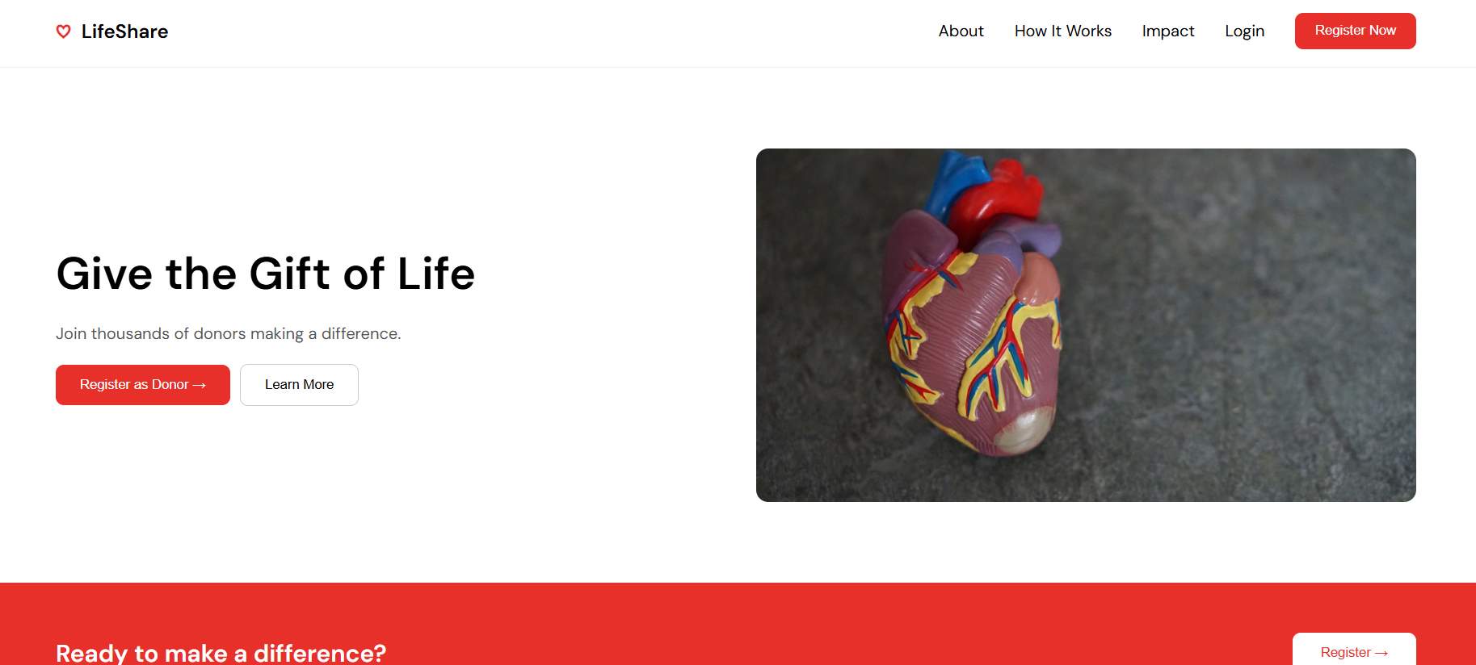
Sample Output ScreenShot:
Home Page

Slide 28
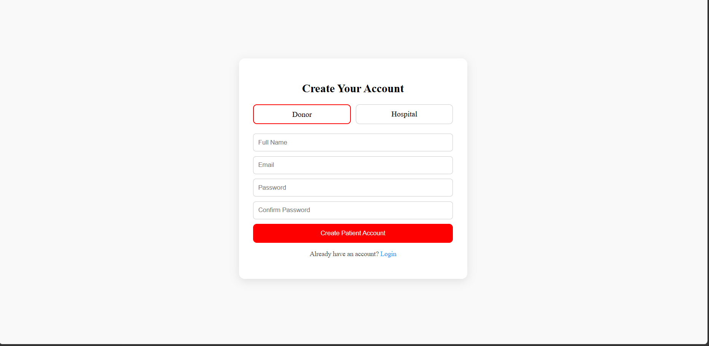
Registration Page

Slide 29
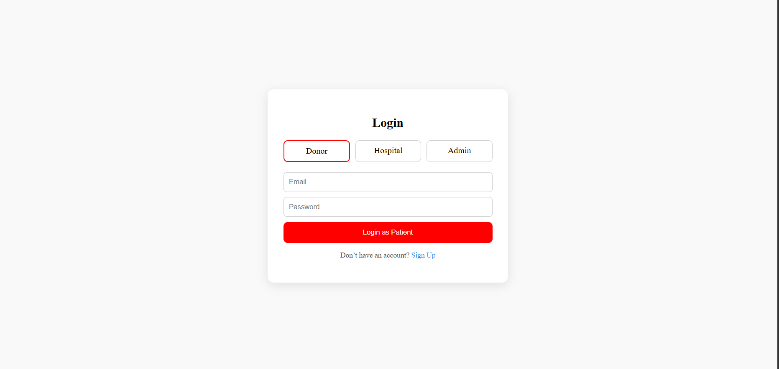
Login Page

Slide 30
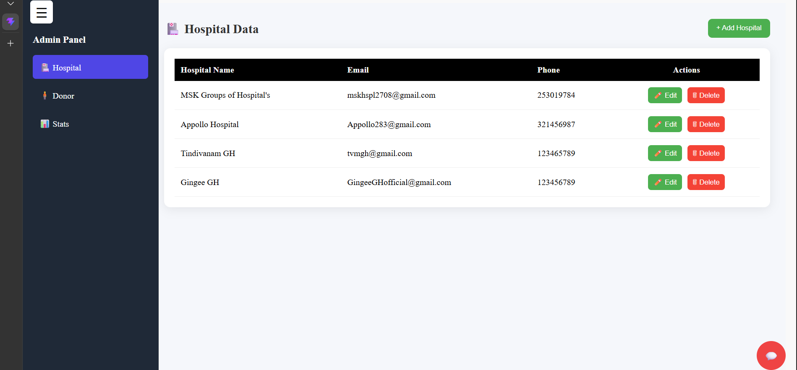
Admin Page

Slide 31
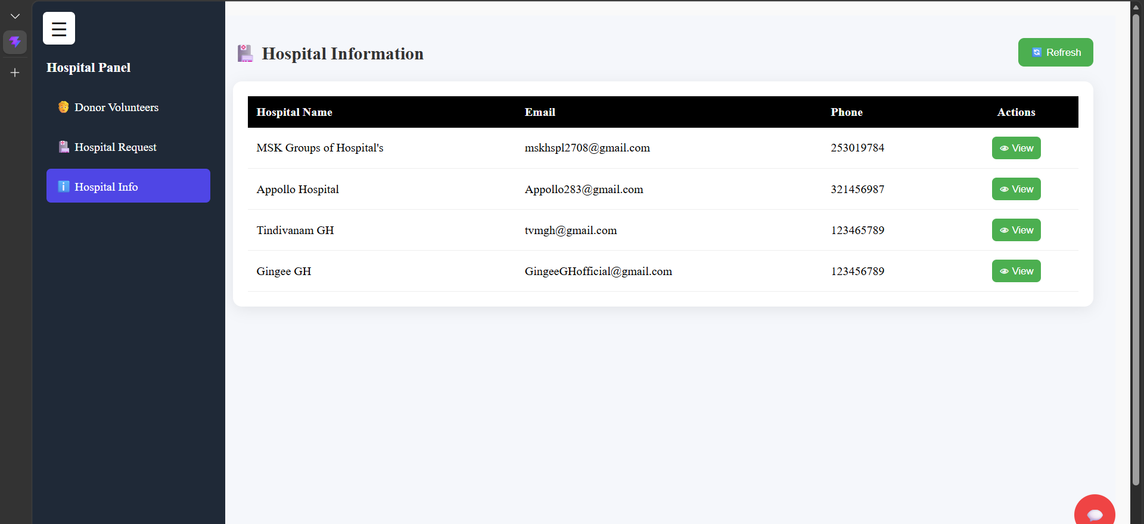
Hospital Dashboard

Slide 32
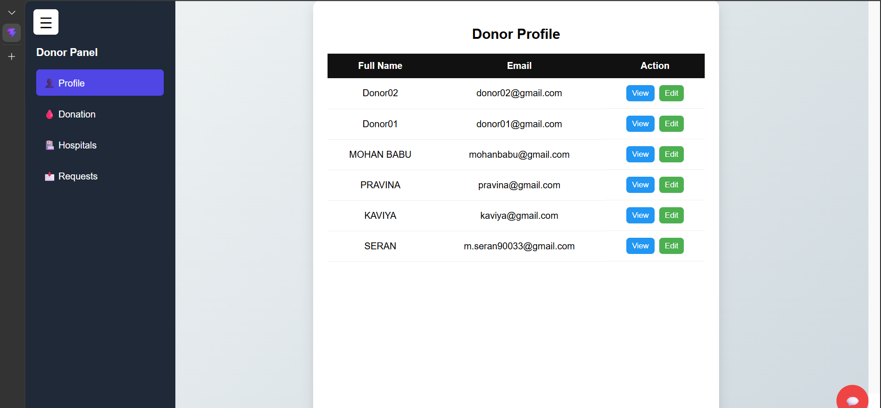
Donor Dashboard

Slide 33
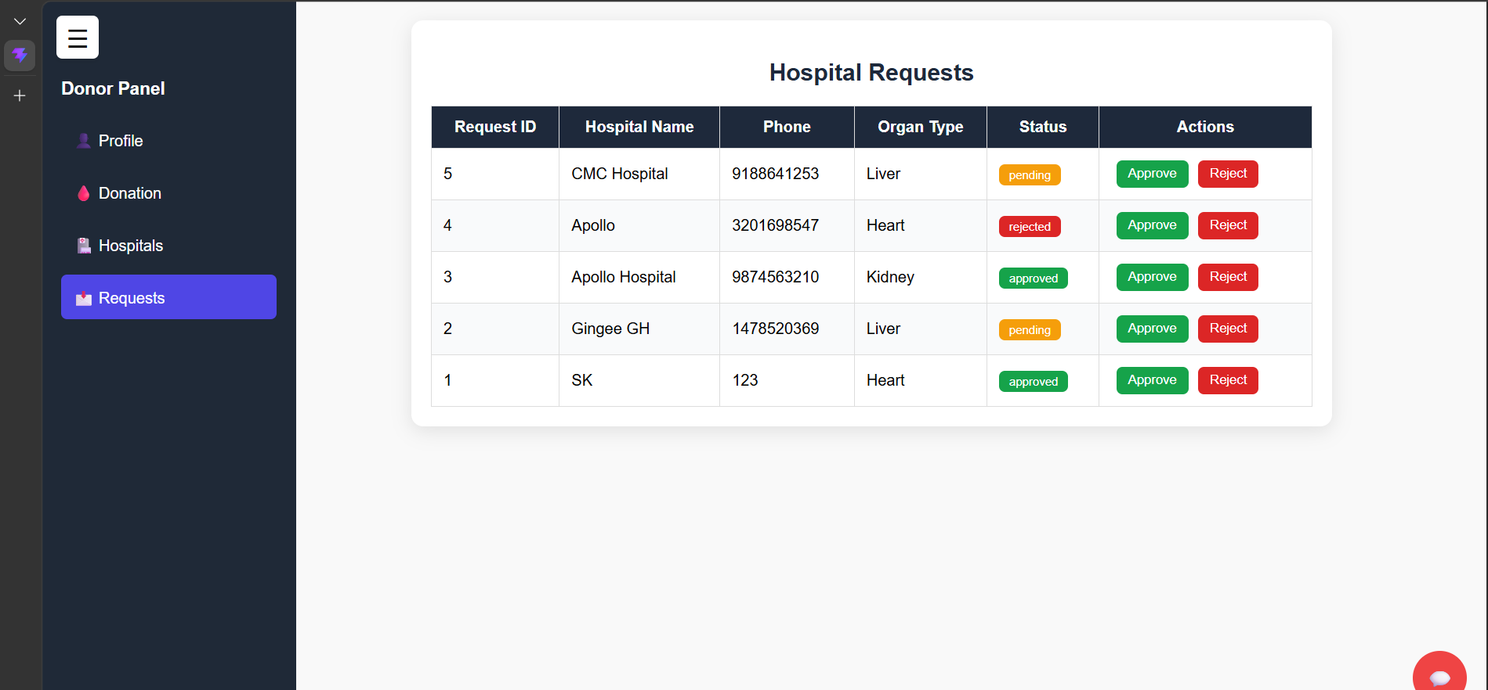
Hospital Request Dashboard

Slide 34
Conclusion:
The Organ Donation & Hospital Coordination Web Platform is a secure and efficient web-based solution designed to improve communication and coordination among donors, patients, and hospitals. By providing a centralized platform for organ requests, donor management, real-time tracking, and emergency notifications, the system helps reduce delays and improve transparency in the organ donation process. The use of modern full-stack technologies ensures scalability, reliability, and data security. Overall, this platform has the potential to enhance organ donation management, minimize organ wastage, and contribute to saving more lives through effective digital healthcare coordination.

Slide 35
References:
G. Muddu Krishna; S. Nagaraju (2016), “Design and implementation of short message service (SMS) based organ donation bank”, 2016 International Conference on Inventive Computation Technologies (ICICT).
Vikas Kulshreshtha, Dr. Sharad Maheshwari, “Benefits of organ donation bank administration system”, Singhania University, Jhunjhunu, Rajasthan, India and Government Engineering College Jhalawar, Rajasthan, India.
Alfouzan, N., “Knowledge, attitudes, and motivations towards organ donation among King Abdulaziz Medical City”, Population.International journal of family medicine, vol. 2014.
Arif, M., Nafseer S., K., Rahul, R., “Automated online Organ Donation bank database”, Proceedings of the India Conference (INDICON), India, 2012.
Organ, G., “How your body replaces organ ”International Research Journal Of Modernization In Engineering Technology And Science 2018.

Slide 36
THANK YOU…

